Slide 1
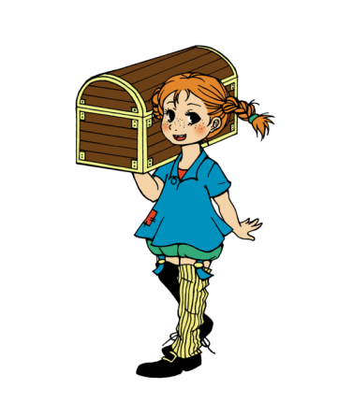


Pippi‘s travel diary - Slovenia
The world is fool of amazing things.
Let‘s go, and find them!

Slide 2
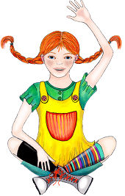
My journey began...
Hello friends! This is my travel diary from Slovenia.The children here call me Pika Nogavička.
They are all very friendly. I asked them to tell me something about their homeland.
Let‘s see, what they told me…

Slide 3
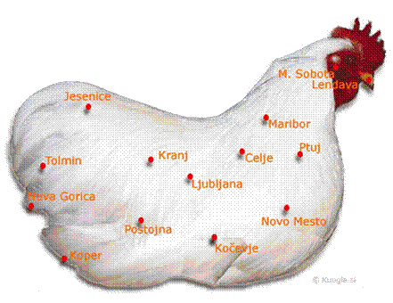
National symbols
Slovenia is a small, beautiful country. It has the shape of a hen.

Slide 4
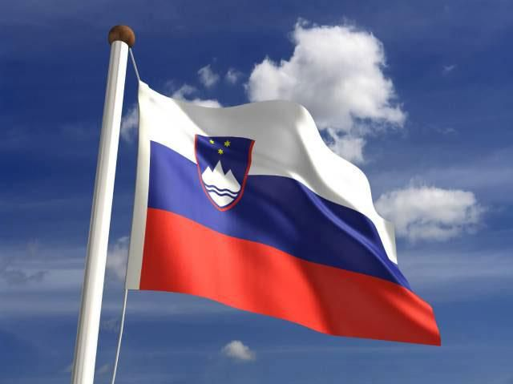

National symbols
Its flag has 3 fields: white, blue and red. Its coat of arms consists of three symbols: 3 golden stars, the mountain Triglav and 3 waves that symbolize the water.

Slide 5
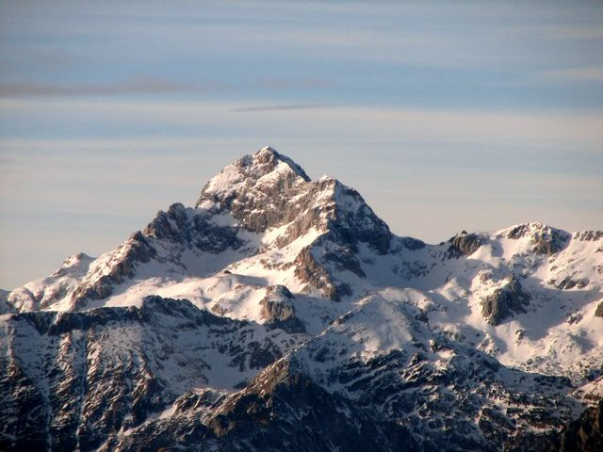
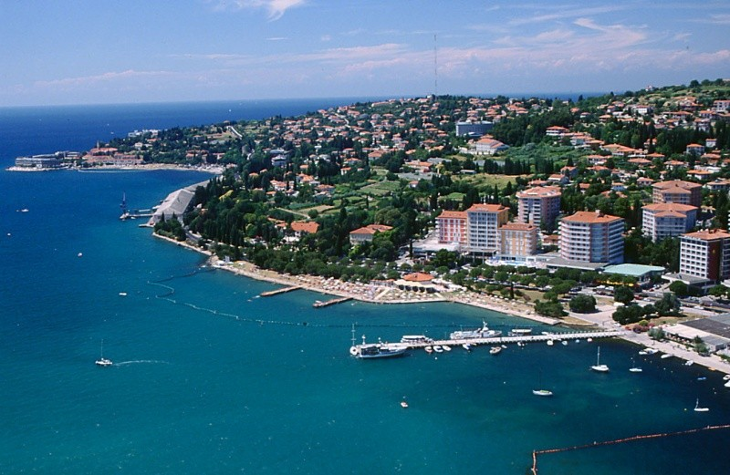
Landscape
In Slovenia everyone finds his own favorite place.
If you love high mountains, you have to visit the northwest part of the country.
If you like to bath in the sea, you have to go to the southwest.

Slide 6

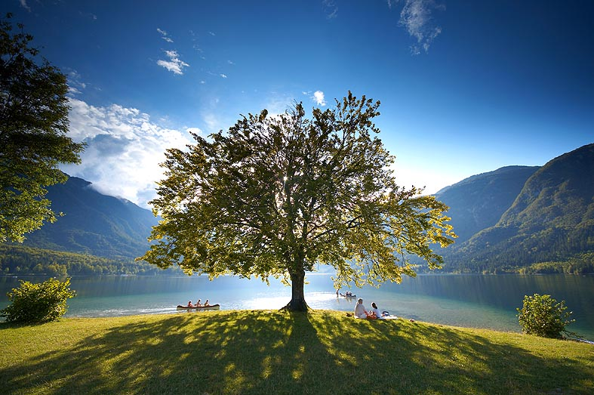
Landscape
Slovenia is also called the green country. 57%of Slovenia’s surface is covered by forests.
We also have many beautiful streams, waterfalls, rivers and lakes.

Slide 7
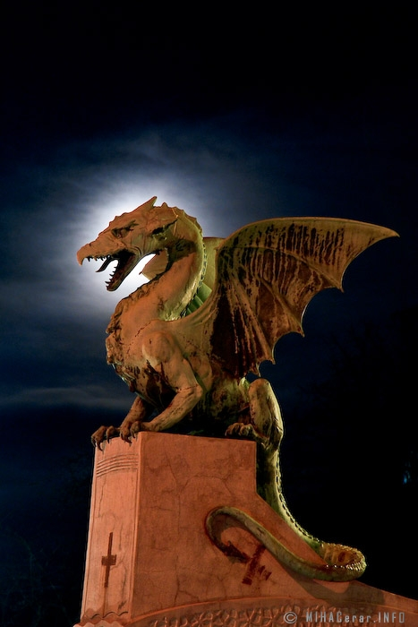
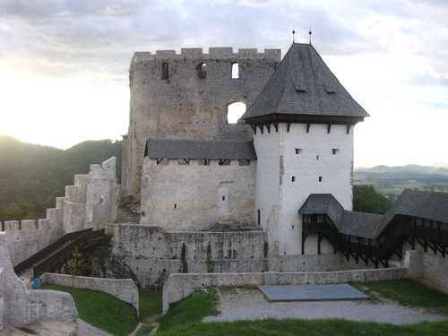
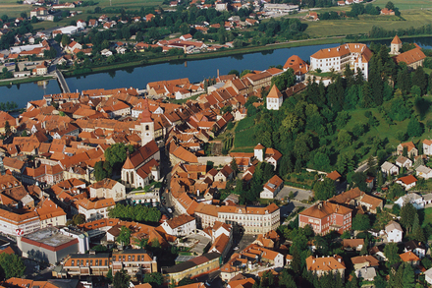
Landscape
And if you are more of an adventurist, you can follow the trail of the long forgotten times. Almost every city in Slovenia has a long history that goes back to the Roman times.

Slide 8
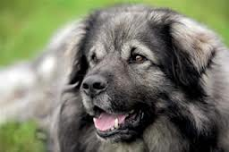
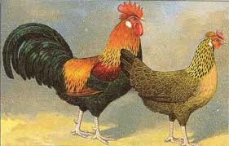
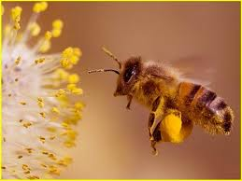
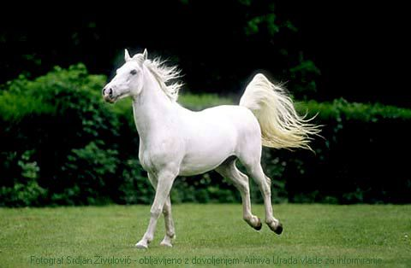
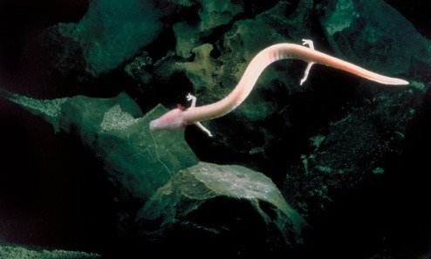
Fauna
Although Slovenia is very small, you can find a big variety of living creatures there. Some of the animal species are indigenous: for example the Carniolan bee, the proteus, the Styrian hen and the Karst shepherd.
Slovenia is also known as the homeland of the majestic white
Lipizzaner horse.

Slide 9
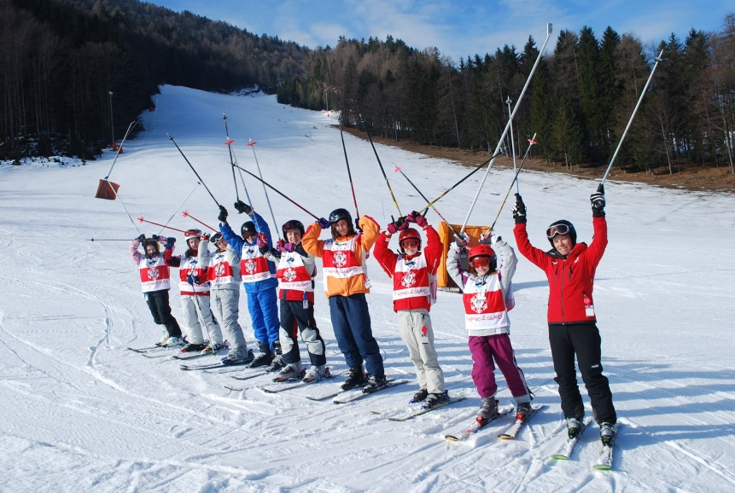
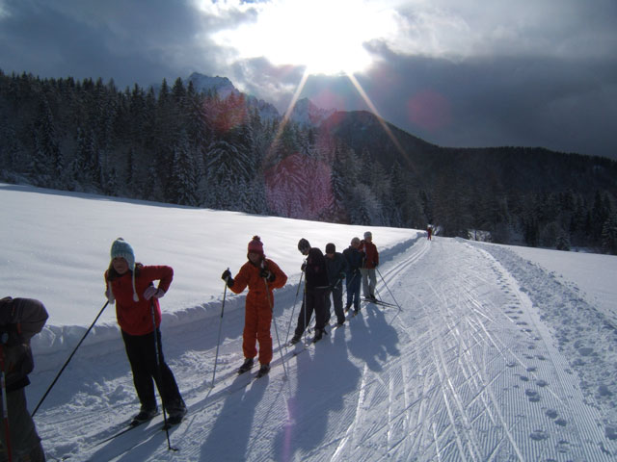
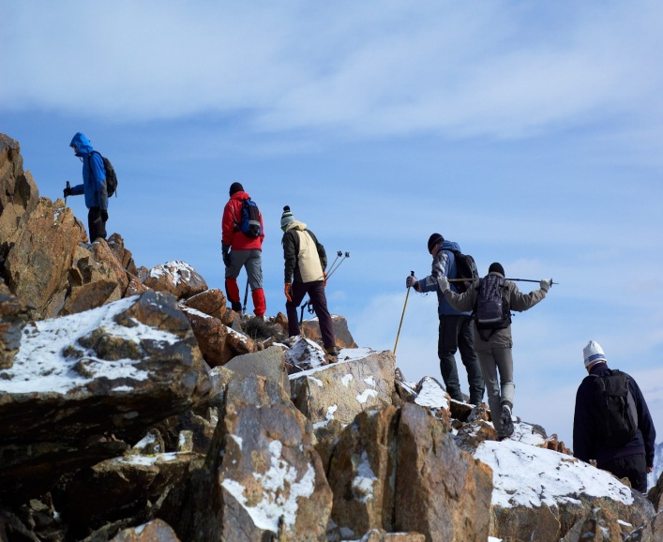
Sports
We like to call ourselves a very sporty nation. The favorite sports of the Slovenes are: skiing, cross country skiing and mountain climbing. But of course meny people also play soccer, basketball, handball and tennis, like everywhere else.

Slide 10
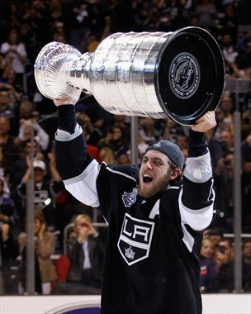
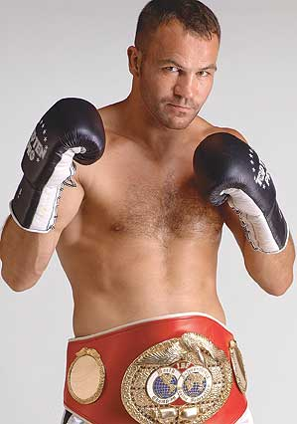
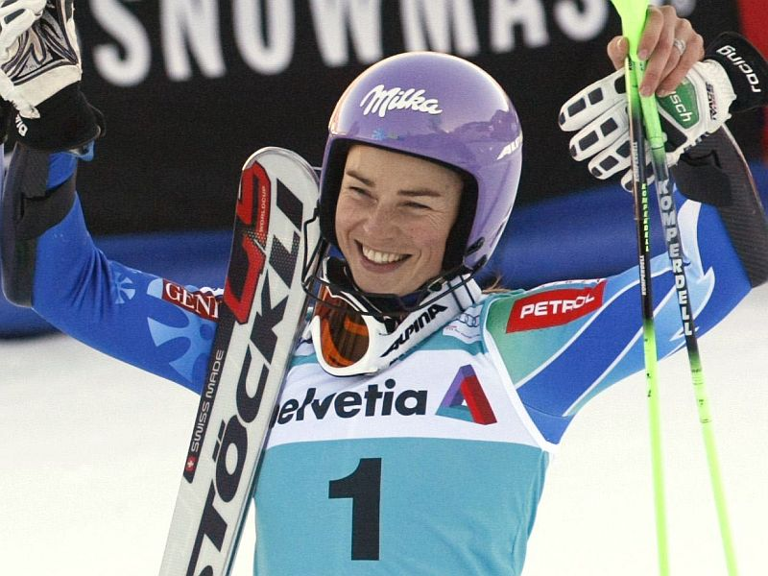
Sports
There are only a little over 2 Millions of us, but we have many excellent sportsmen and sportswomen. ☺ If you like skiing, you probably have heard of our skier Tina Maze. This year, she won many medals. Of course, she isn’t the only successful athlete. Many of them are well known and some of them play for different sports teams all over the world.
Anže Kopitar – hockey player
Tina Maze - skier
Dejan Zavec- boxer

Slide 11
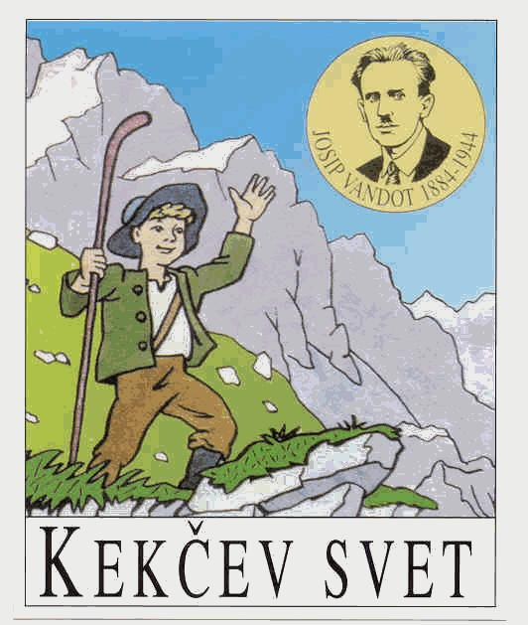
Arts
Because the Slovene language is spoken by relatively few people, our story books, poems and movies aren't known all over the world.
Nevertheless, we are very proud of our authors, who wrote some great stories. One, for example, is the writer Josip Vandot. His story about a brave and cunning boy, called Kekec was also made into a movie.
Here is a song (from this movie) all children in Slovenia know…

Slide 12
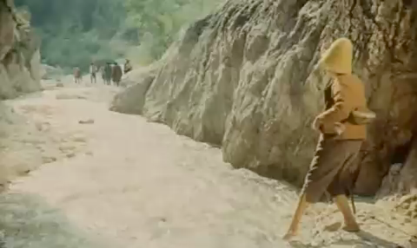

Slide 13
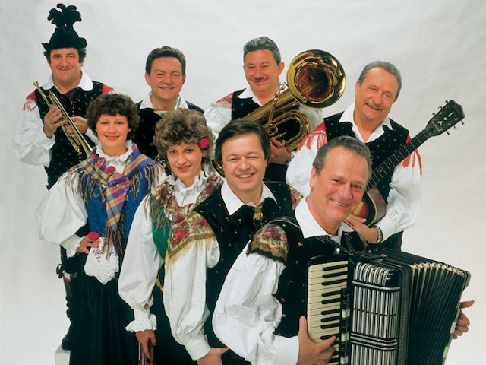

Arts
The Slovenian folk music is very lively. It is always played by an accordion and some wind instruments. The instant, you hear it, you just can't sit still. Try it… ☺

Slide 14
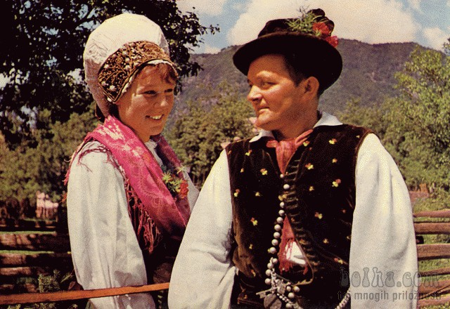
National costumes
There isn't only one typical national costume in Slovenia… Every region has its own style, but since the 19. Century a combination of all stiles made up a costume that is still worn on folk festivals as the Slovene national costume. What does it look like?
Well, the men‘s hats are decorated with capercaillie feathers, their leather trousers end just under the knees and the vest is decorated with tiny embroidered carnations.
The women wear a special head cover, called avba, a colourful scarf with fringes covers their shoulders, and their dresses are long and tight to the waist.

Slide 15
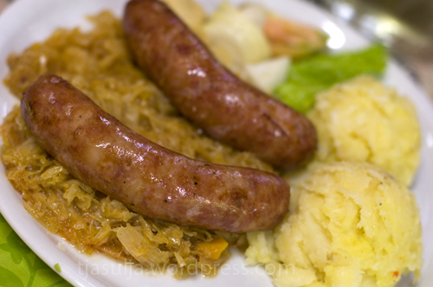
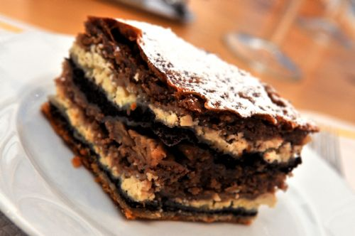
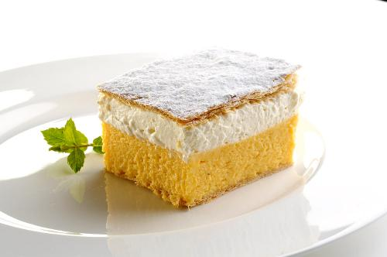
Food
Typical Slovenian food is hearty. It consists of potatoes, cabbage, turnips and different types of sausages or roast.
But the best are the sweets, prepared by the Slovenian confectioners. The cream cakes - kremšnite, prekmurske gibanice and potice are simply
mouth-watering.

Slide 16
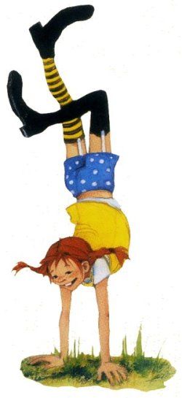
Like you, the children in Slovenia also have to go to school. They start primary school, when they are 6 years old. Before that age, they go to the kindergarten. There they play and learn, some of them also learn a little English. And they want to say Hi...

Slide 17
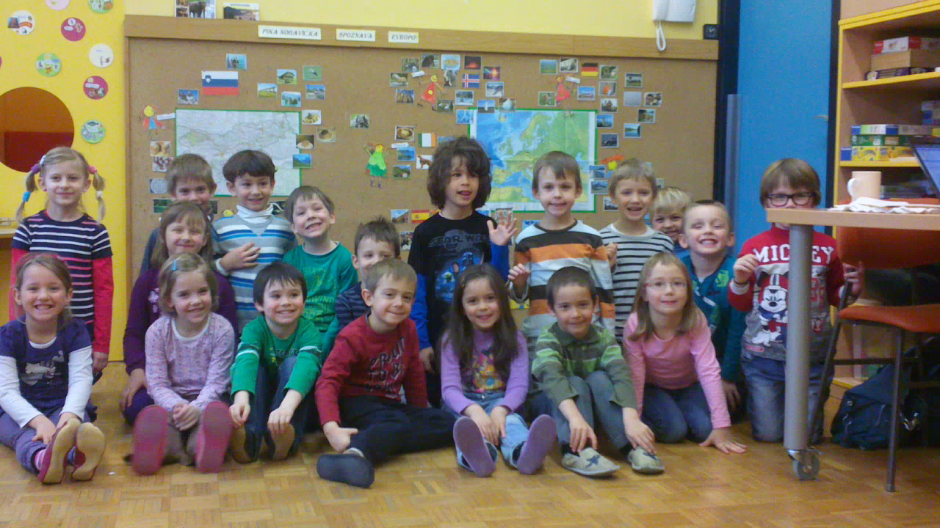

Slide 18
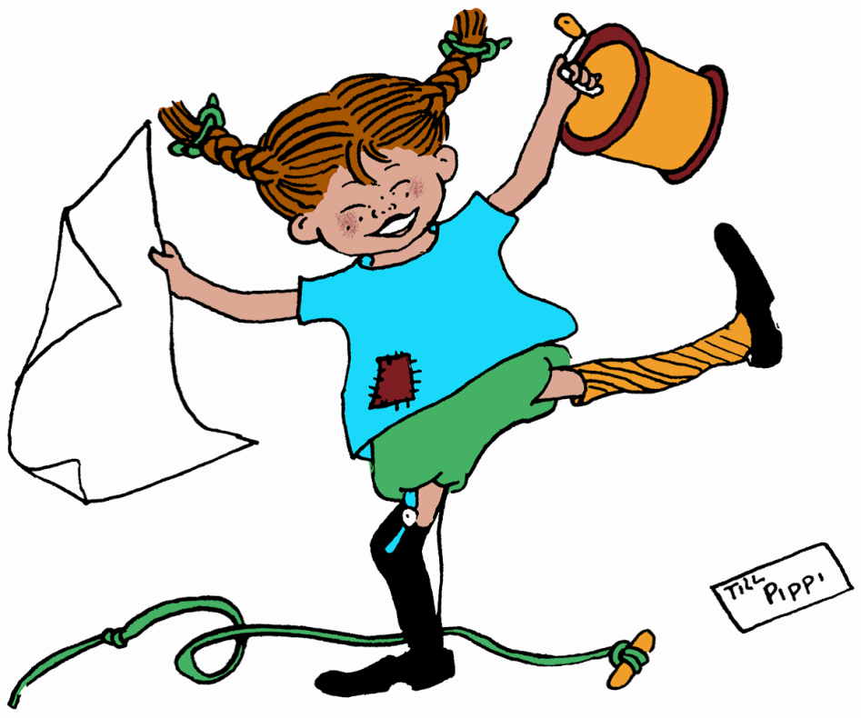
Of course, I wanted to play with them, so they showed me all of their favorite games.
We played many fantastic games, we danced and we jumped over the jump rope… We went for walks and they took me along on great trips.
I realy enjoyed my visit to Slovenia.

Slide 19
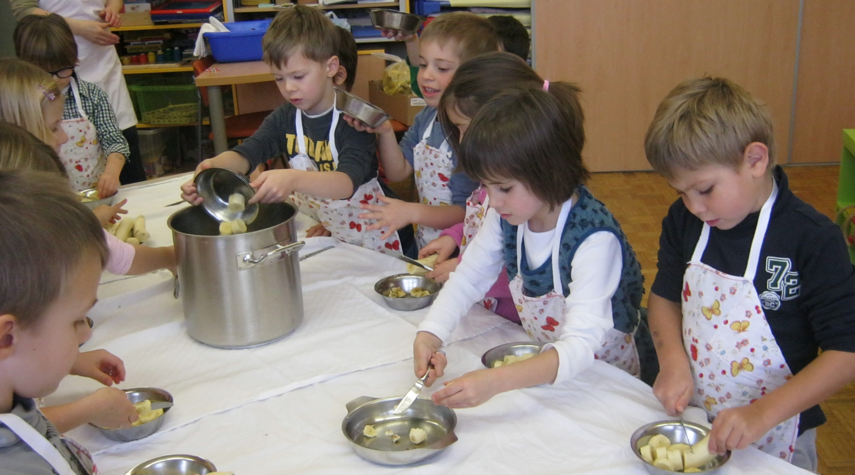
We prepared a yummy banana-milkshake.

Slide 20
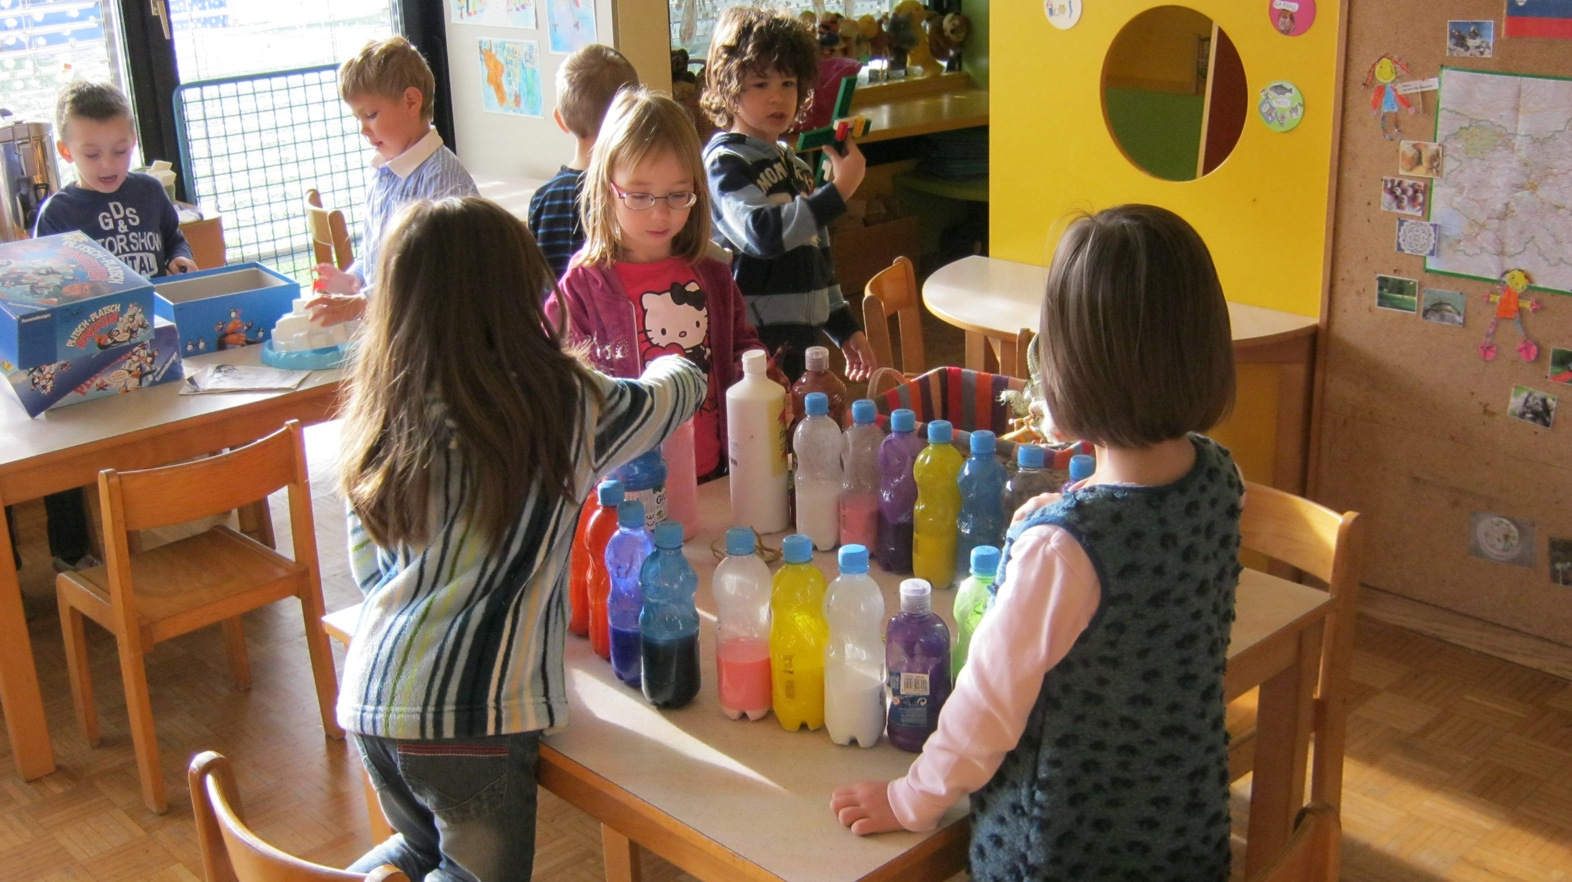
We played with colours.

Slide 21
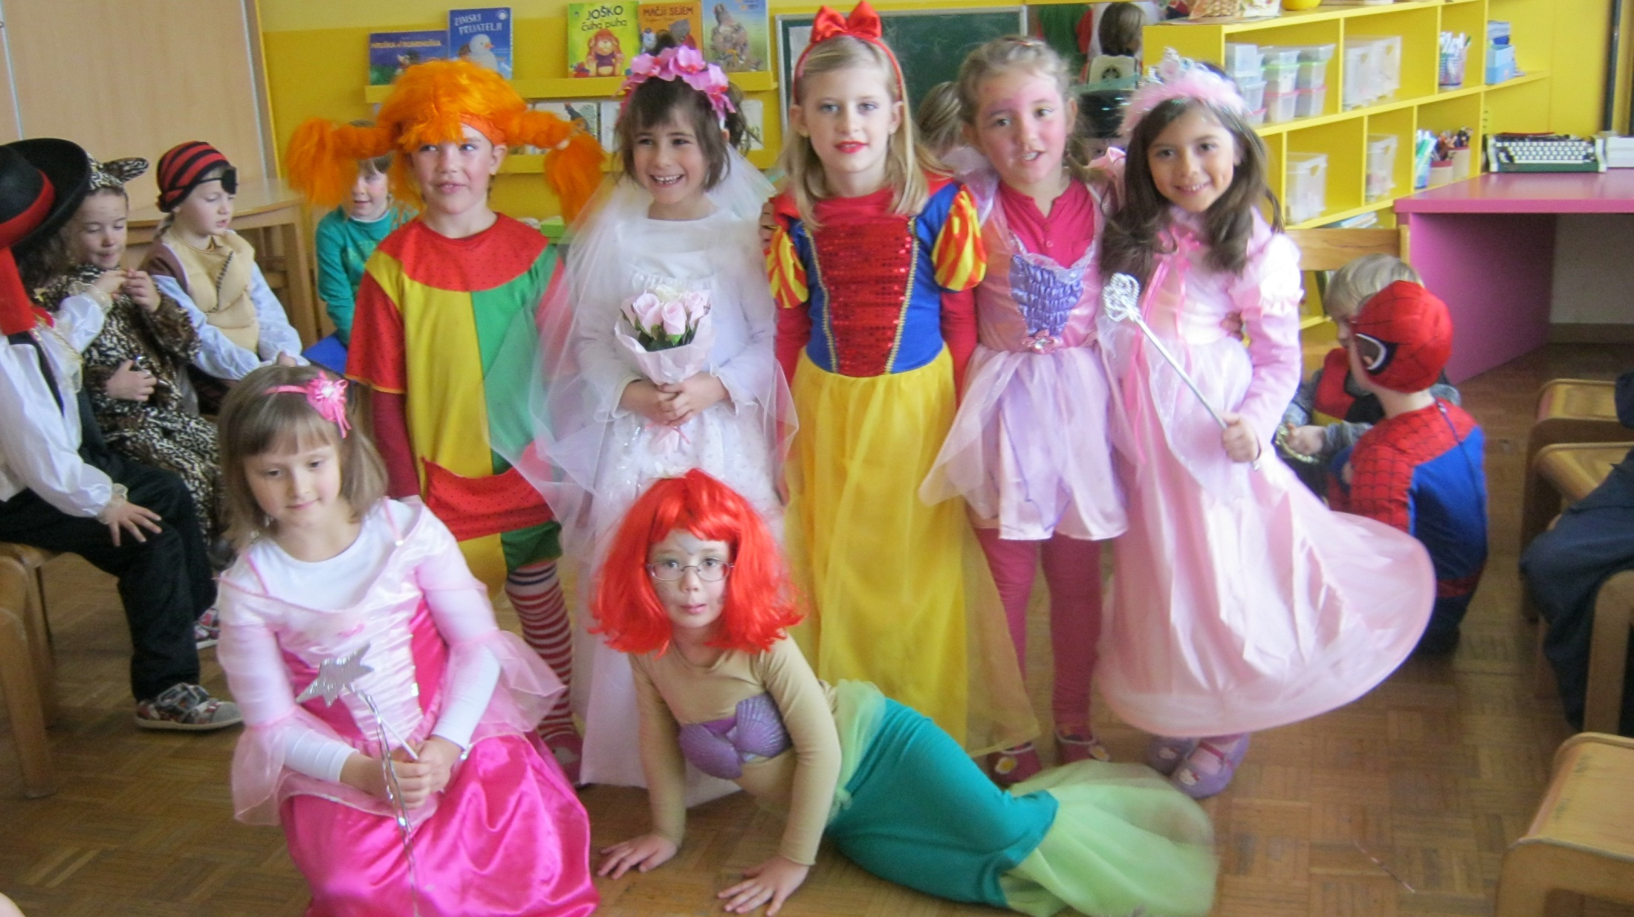
Carnival is always fun…
For one day, we can be, whoever we want!

Slide 22
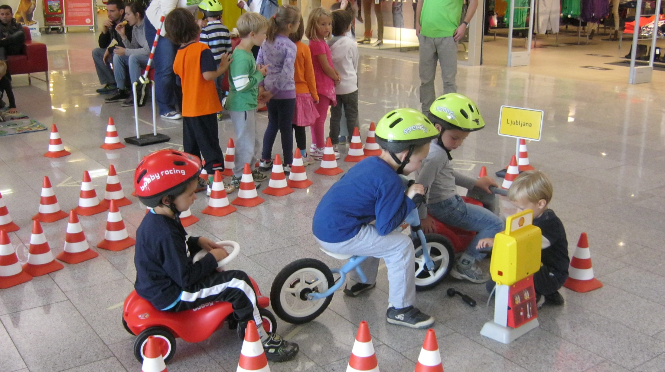
A box-stop. This tires need to be changed…

Slide 23
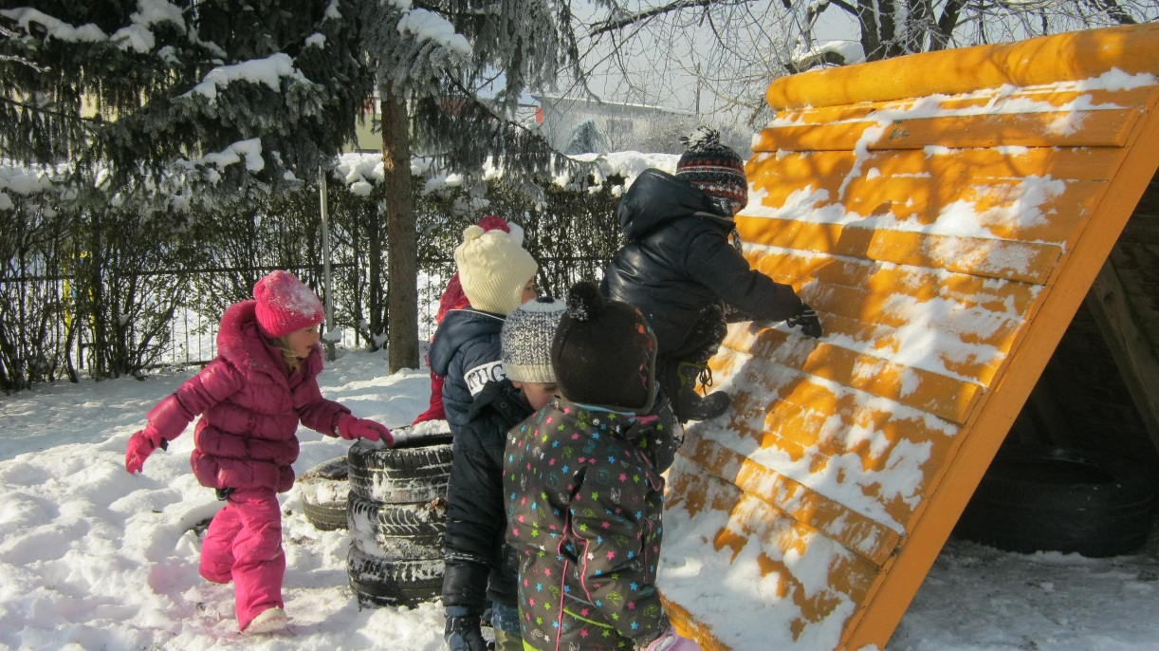
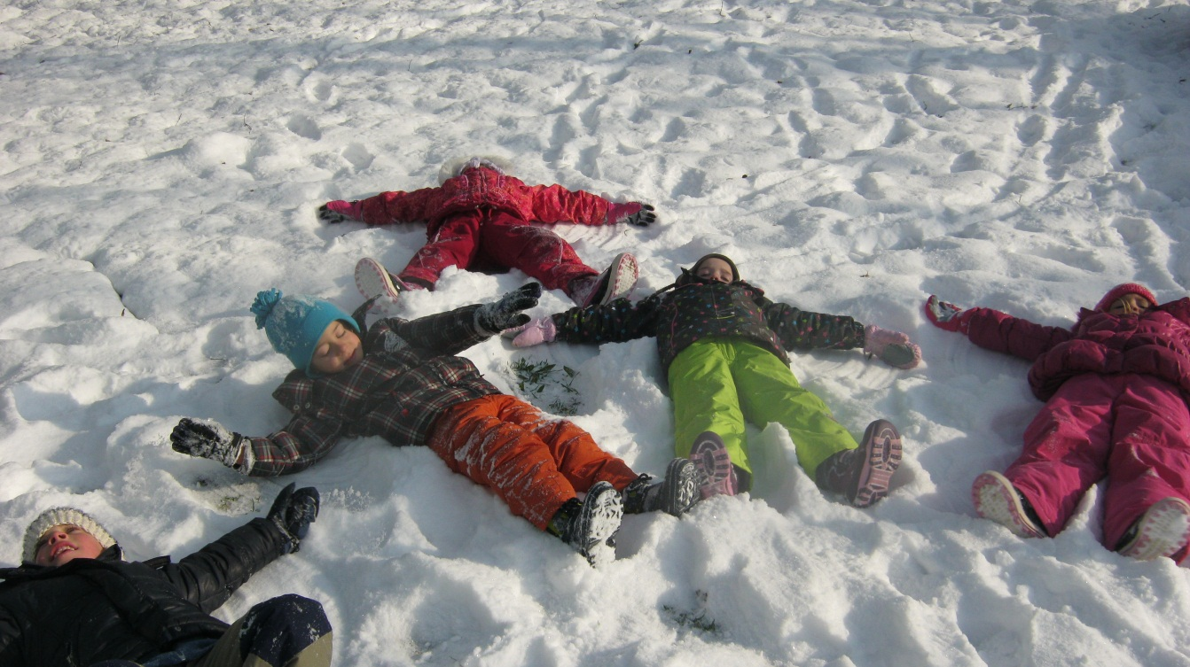
We enjoyed the snowy days.

Slide 24
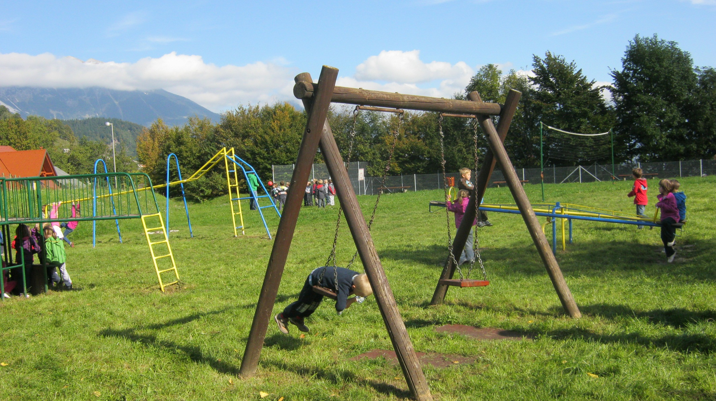
But the sunny, autumn days were also great. We can‘t wait for the spring to begin.

